Slide 1

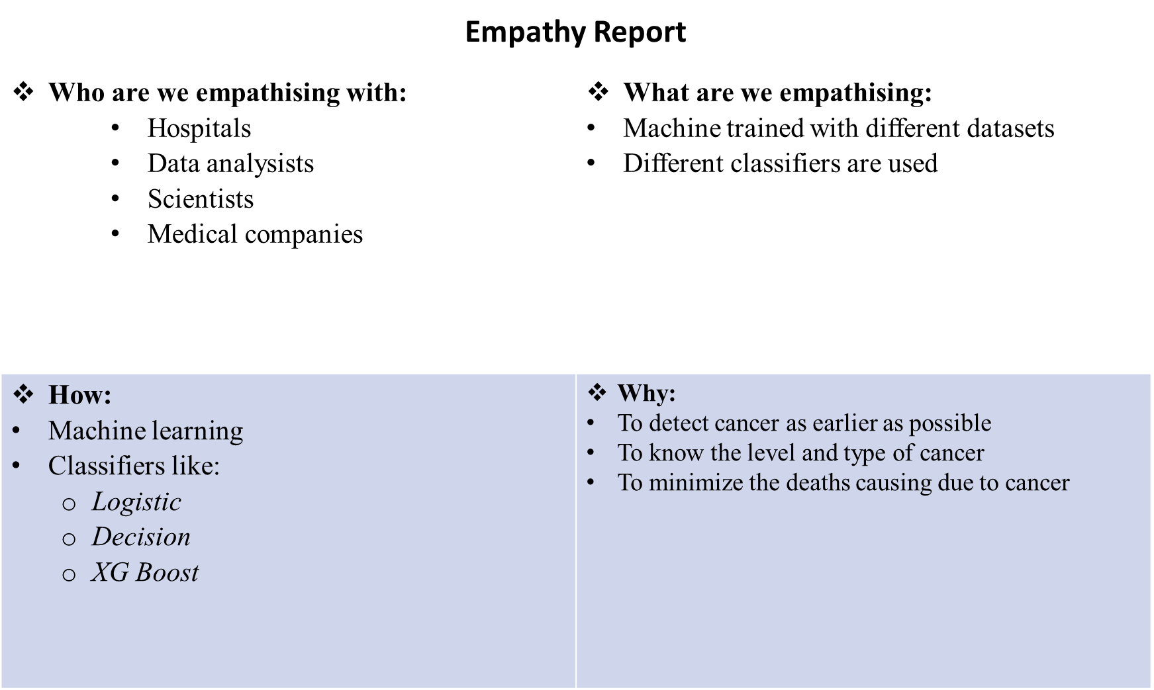
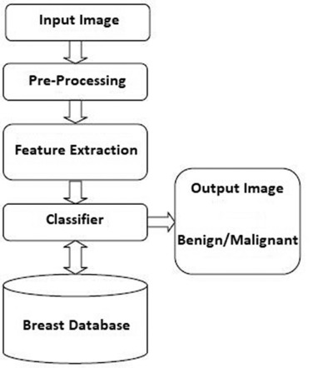
Proposed Architecture/ Diagram:
MIT SCHOOL OF COMPUTING
Class : CORE 2
Group Id: 7
DEPARTMENT OF COMPUTER SCIENCE & ENGINEERING
CANCER DETECTION USING MACHINE LEARNING
Rohit Khare Pranav Deshpande Harshal Jadhav
Faculty Guide:
Prof. Shahin Makubhai
Abstract/ Objectives:
Empathy Chart
Ideation
Our target customer is clinics and hospitals, who are faced with overwhelming amount of data to process and very little time.
We are planning to train the machie using different classifiers and by entering the medical values the users can get to know the type and level of cancers.
Also different medical entities like pharmaceutical companies can analyze the proportion of detection of cancer.
Proposed Block diagram
P
1. The project can be accessed by unlimited number of users.
2.The user can analyze the proportion of cancer patients versus time.
3.The users can analyze overall symptoms and different levels of cancer
4. . Different classifiers are used and tried on resulting in improvement of accuracy and efficiency.
Lung Cancer Dataset
Early detection of cancer in patients from lab reports using machine learning
Proposed Solution
Training the machine using datasets available using different classifiers.
Scope and Feasibility
The project can be used by most of the entities in the medical field

